Slide 1


Variability of Classification Accuracy
Ngoc Ty Nguyen; Mengling He
Adviser: Larry Tang
National Center for Forensic Science,
University of Central Florida
Department of Statistics & Data Science,
University of Central Florida
June 8, 2021

Slide 2
Introduction
Variability in the ROC curve
R Shiny App Application
Variability in the covariate-specific ROC curve
ROC regression accounting for demographic effect
Variability in ROC curve in post Lasso selection
Performance of PCA+ LDA and Lasso+Logistic
Post selection inference for Lasso
Confidence Interval for the Lasso-based ROC

Slide 3
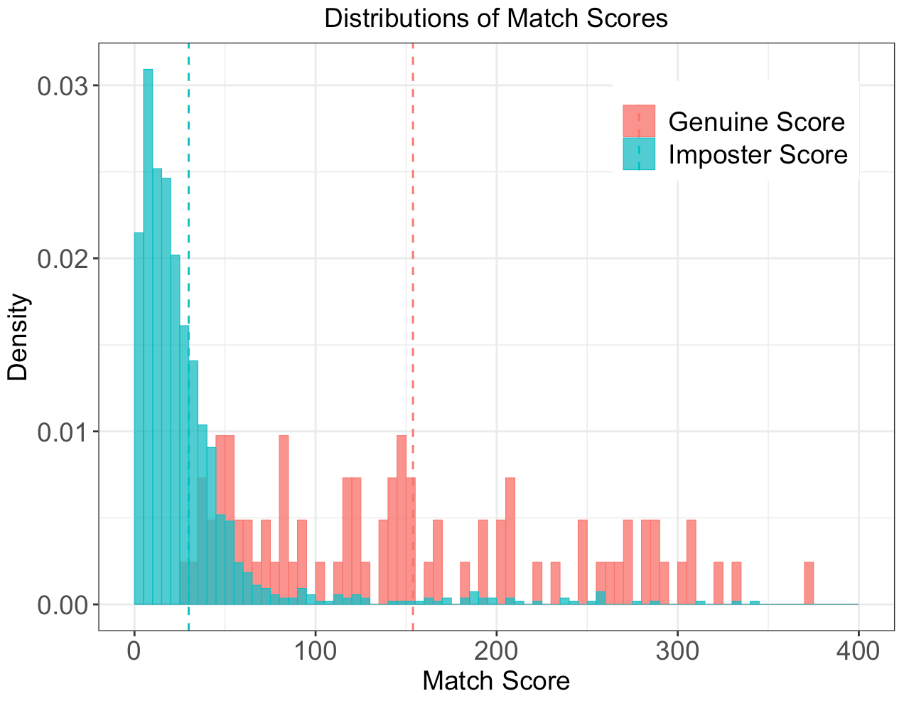
Dataset
Dataset used in the pooled ROC and covariate-specific ROC curve is a subset of the 2012 West Virginia University's FBI BIOCOP
Response variable: Match score
Genuine score: the score obtained by comparing two fingerprint images of the same source
Impostor score : the score that generated by comparing fingerprint images of two different sources
Covariates: Gender; age; ethnicity

Slide 4
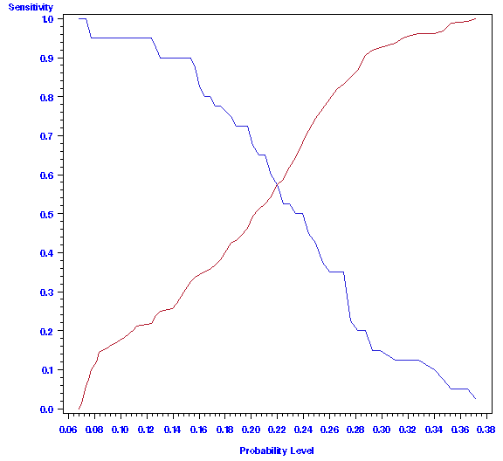
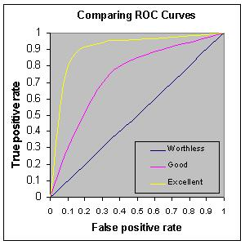
ROC Curve (Zhou, et al., 2009; Pepe, 2004)
For a given cut-point c,
Sensitivity = proportion of genuine scores > c
Specificity = proportion of imposter score ≤ c
Sensitivity
Specificity
Sensitivity
1 - specificity=FPR
The area under the ROC curve (AUC) is a measure of classification accuracy.

Slide 5
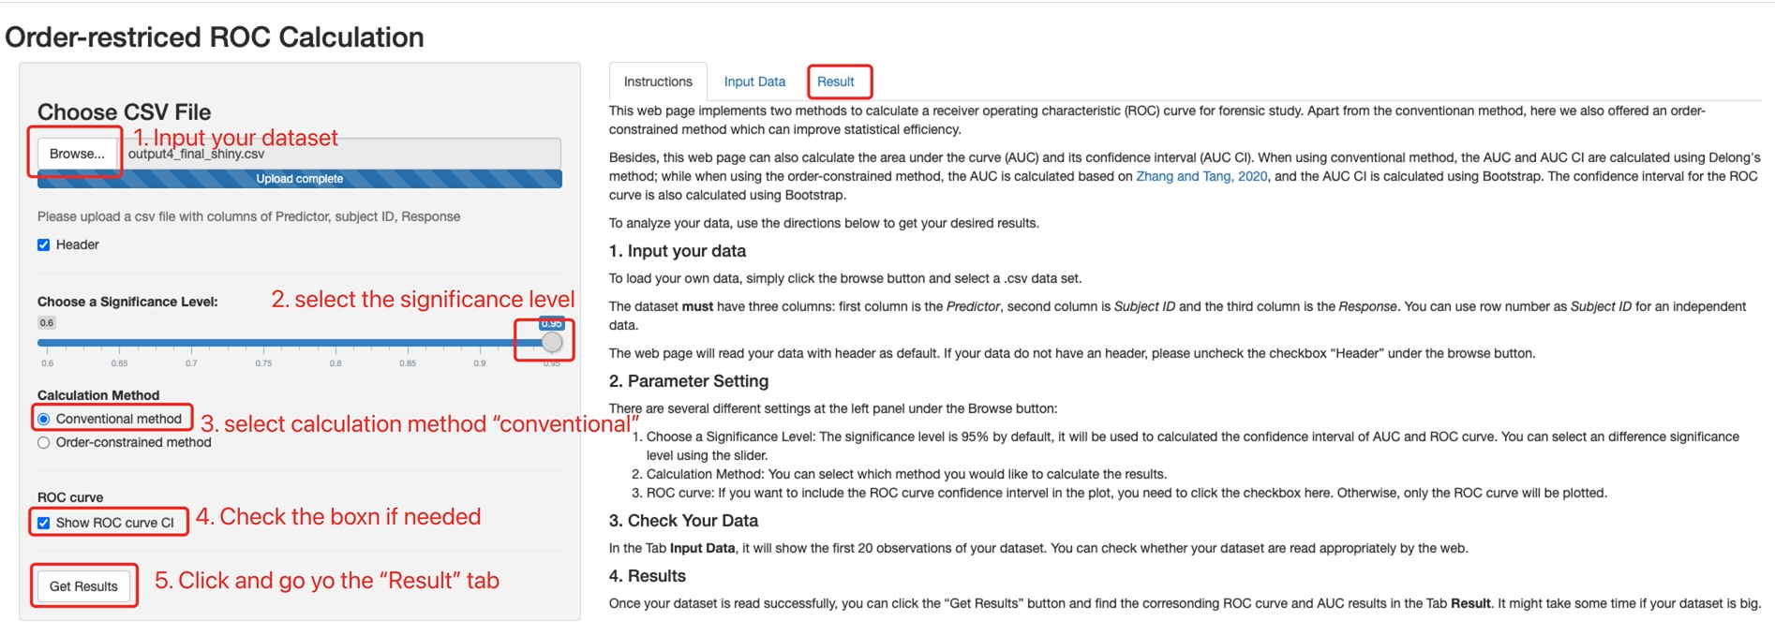
Variability of ROC Curve
Use the R Shiny application: https://menglingheshiny.shinyapps.io/orderROCweb/
Notes:
I wrote this website.

Slide 6
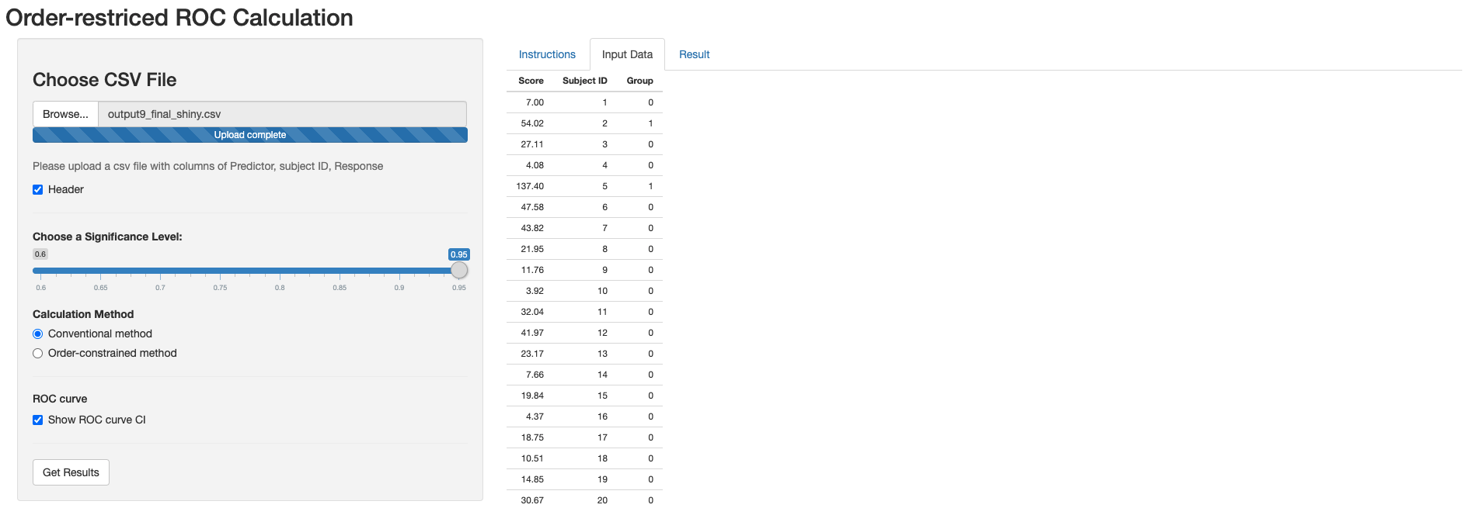
Variability of ROC Curve

Slide 7
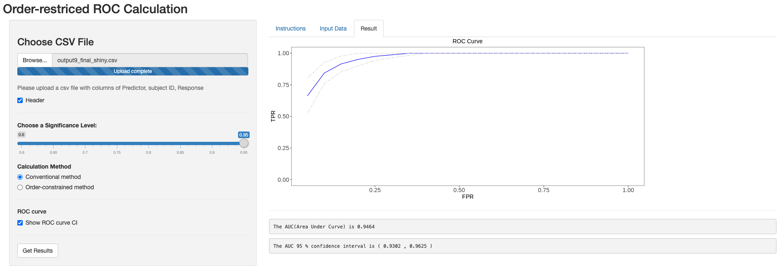
Variability of ROC Curve
AUC and AUC variance: Delong’s method
Elizabeth R. DeLong, D.M.D., Clarke-Pearson, D.L (1988)

Slide 8
Introduction
Variability in the ROC curve
R Shiny App Application
Variability in covariate-specific ROC curve
ROC regression accounting for demographic effect
Variability in ROC curve in post selection
Performance of PCA+ LDA and Lasso+Logistics
Post selection for Lasso
Confidence Interval ROC

Slide 9
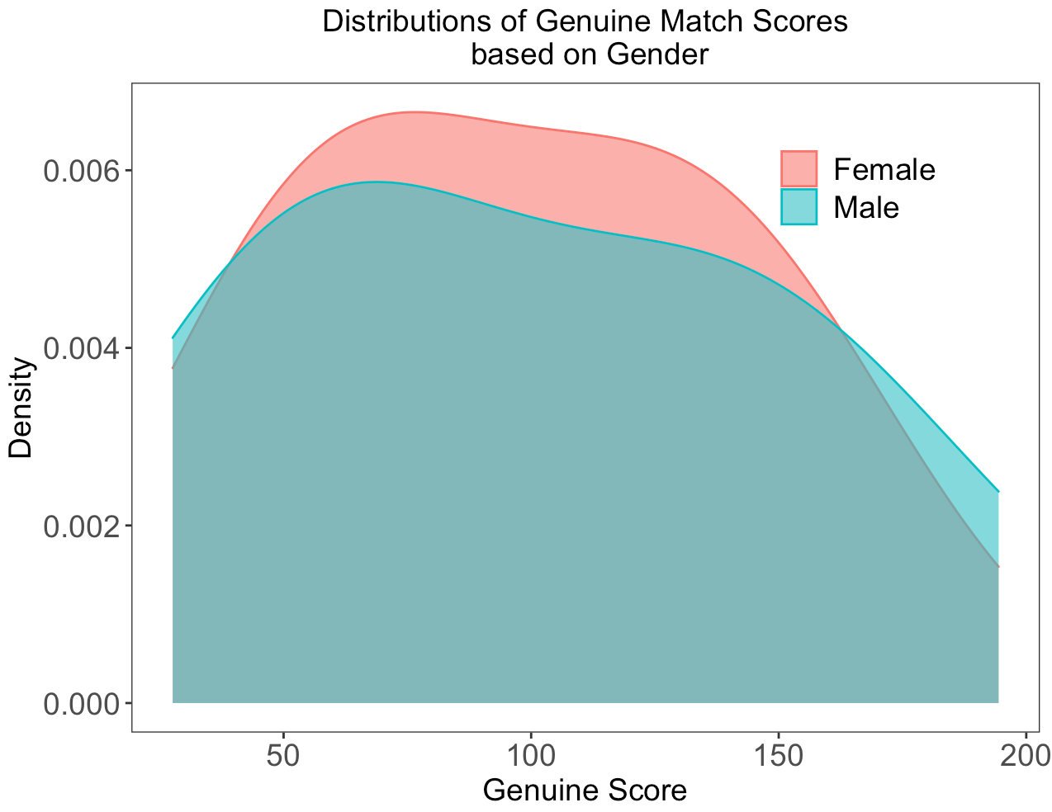
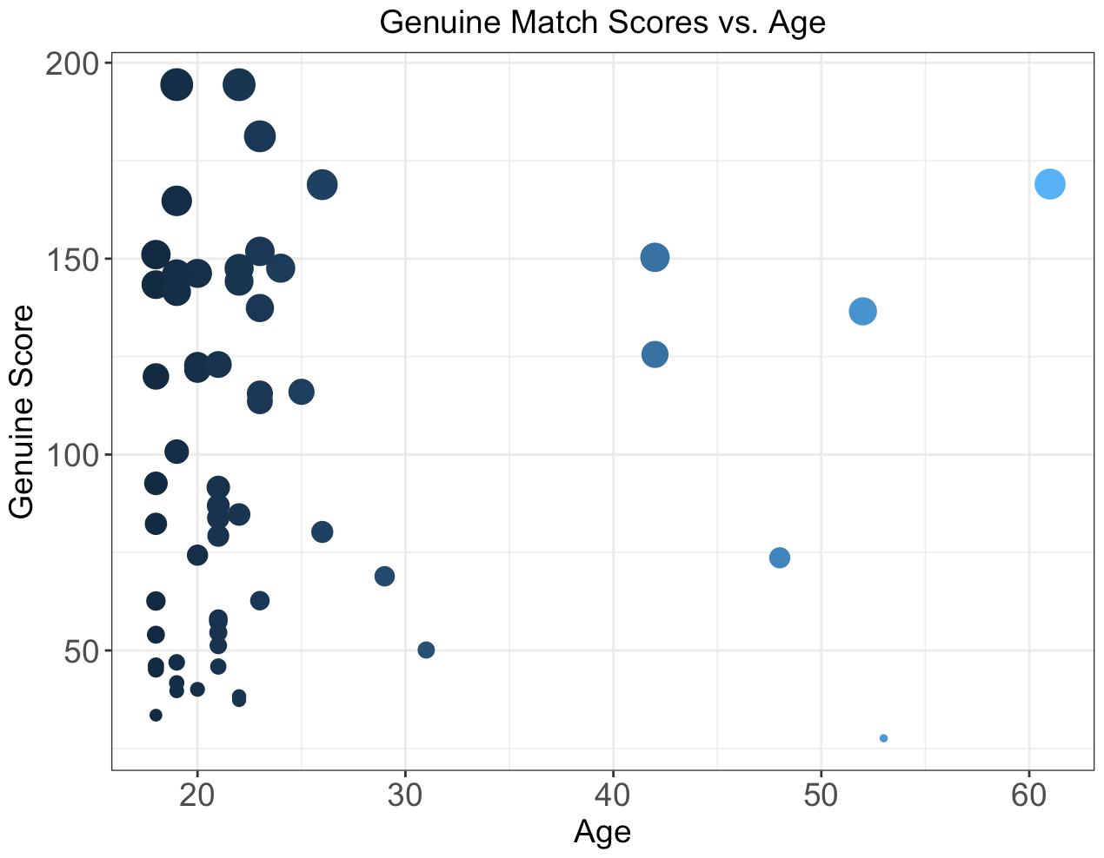
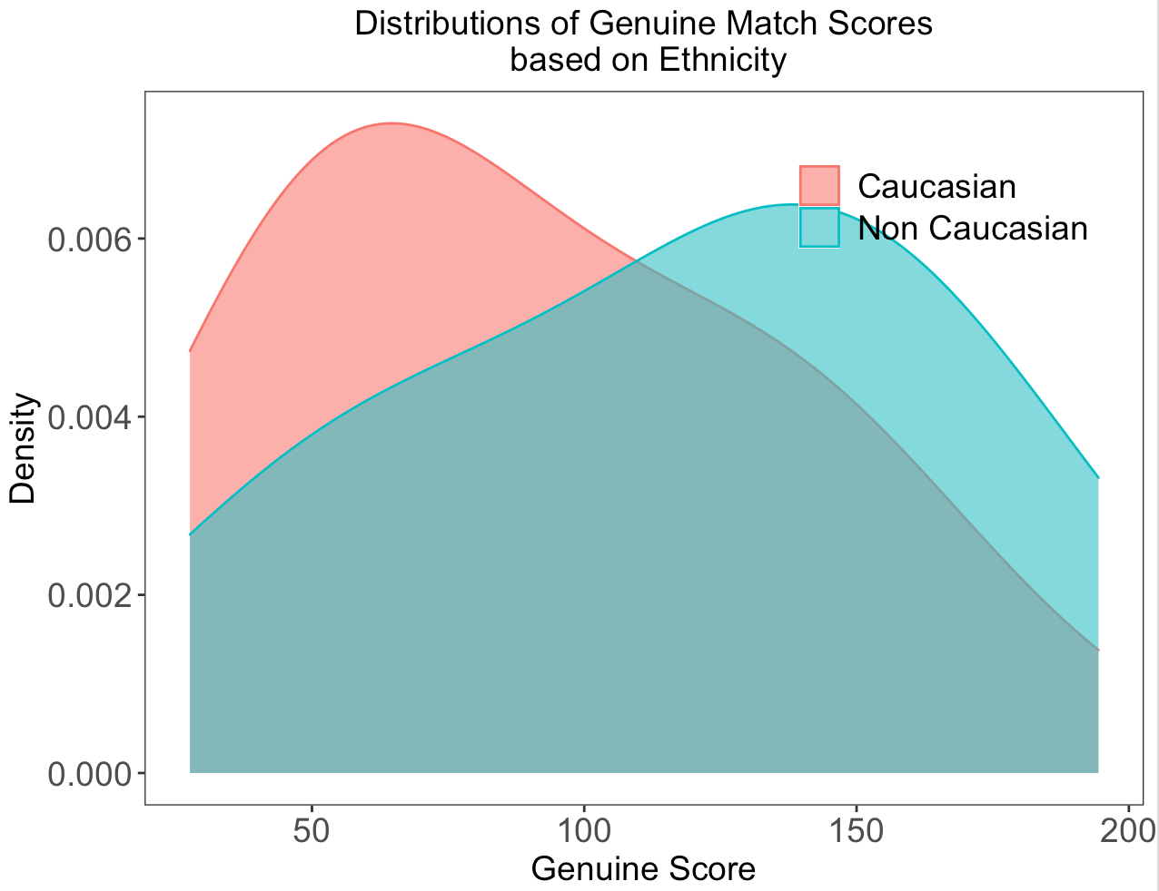
Motivation for Covariate-specific ROC Curve (Pepe, 2004)
Fingerprint match scores vary based on demographics.
How will demographics impact the fairness of the algorithm?

Slide 10
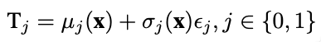
Covariate-specific ROC Curve Method (Pepe, 2004)
$$ROCx\left(u\right)=1−G1[{G0}^{−1}\left(1−u\right)\frac{σ0\left(x\right)}{σ1\left(x\right)}−\frac{μ1(x)−μ0(x)}{σ1(x)}]$$
𝑅𝑂𝐶_{𝑥(}𝑢)=1−𝐺₁[〖𝐺_{0〗^(}−1) (1−𝑢) 𝜎₀₍𝑥)/𝜎₁₍𝑥) −(𝜇₁(𝑥)−𝜇₀(𝑥))/(𝜎₁(𝑥))]
Covariate-specific ROC curve
Linear Regression
Notes:
G0 and G1 denote the CDFs of e0 and e1, respectively. e0 and e1 are zero-mean and unit variance random variables representing the base distributions for D = 0 and D = 1, respectively. which is independent of x;
sigma0(X;↵0⇤) and sigma1(X;↵1⇤) are non-negative scale functions depending on X and an unknown parameter ↵0⇤ and ↵1⇤, respectively.

Slide 11
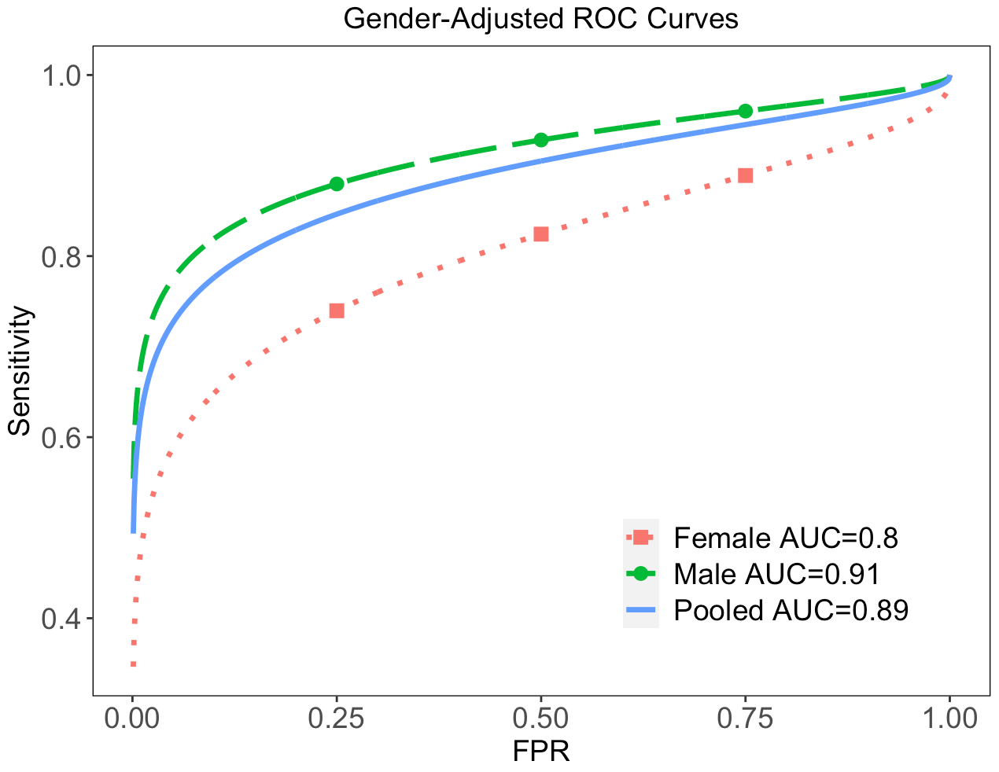
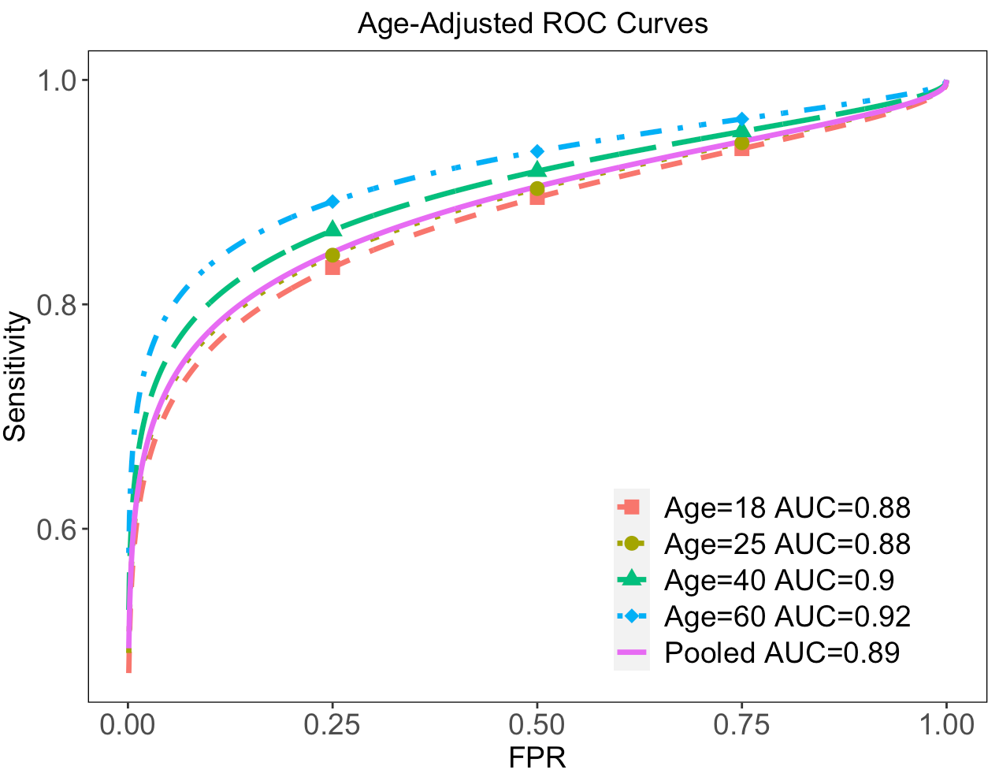
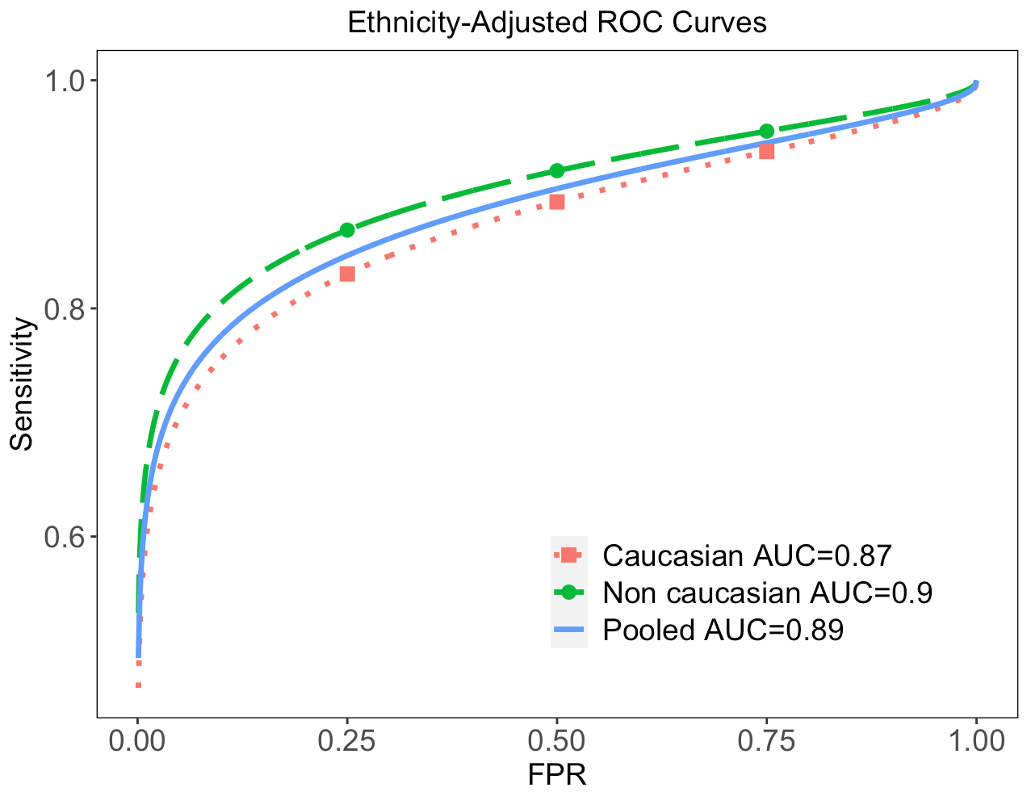
Univariate ROC Regression Model Results
In source identification problems
Gender: Algorithm performs significantly better for male subjects
Age: Algorithm performance better for older subjects.
Ethnicity: Algorithm performs better in Non-Caucasian subjects than the Caucasian ones
Emanuela Marasco, Mengling He, Larry Tang and Sumanth Sriram. (2020)

Slide 12
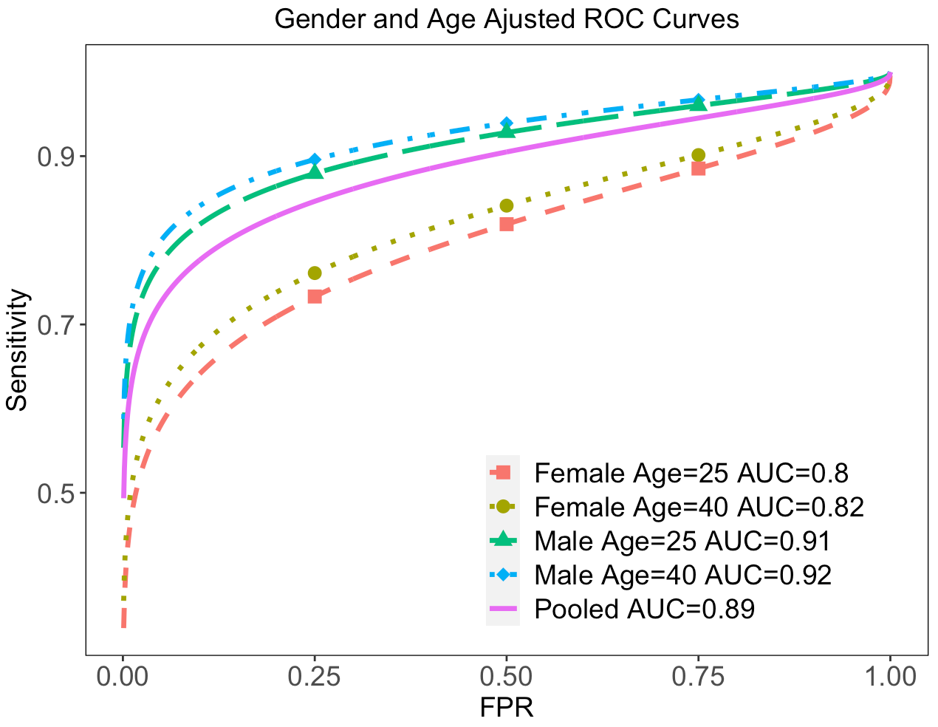
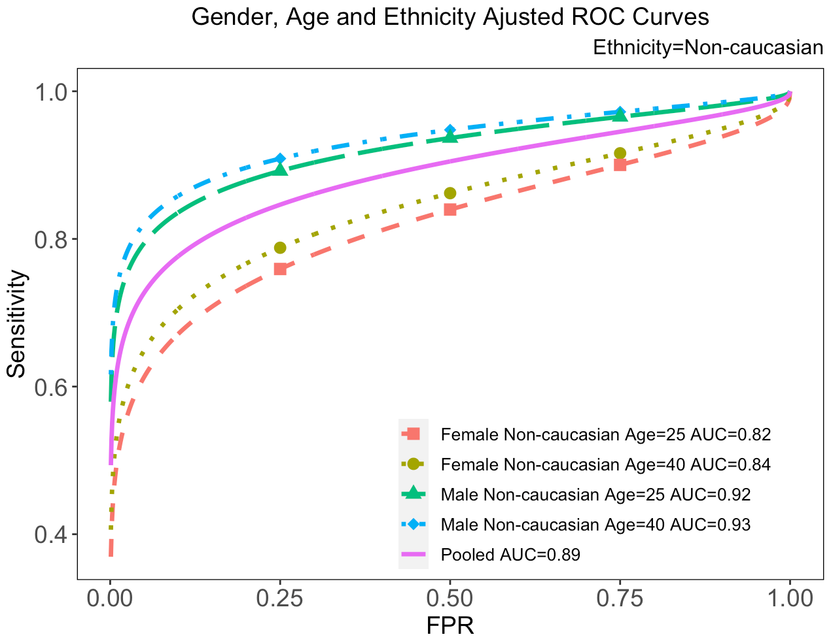
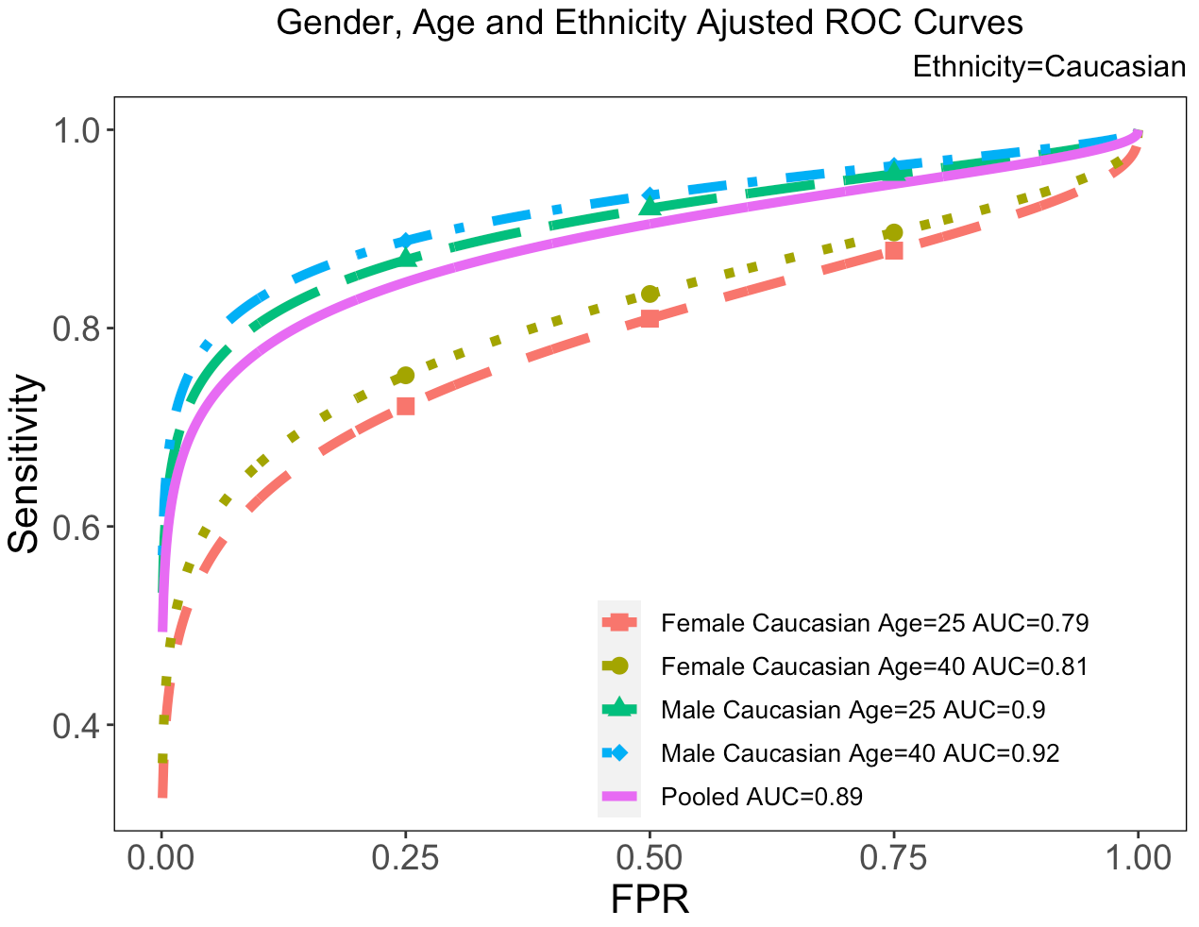
Multivariate ROC Regression Model Results
Notes:
Similar results.

Slide 13
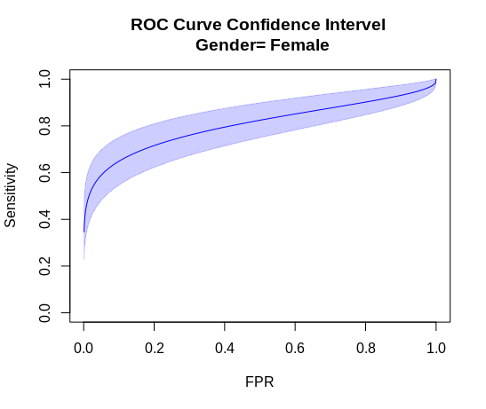
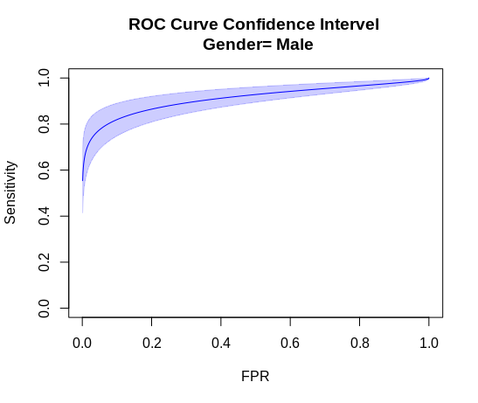
Variability of Covariate-Specific ROC Curve
Bootstrap method is used to estimate the variance of covariate-specific ROC curves.
The regression models are run for 5000 bootstrap samples drawn from the original data set.
The variance of TPR at each FPR point is calculated based on the parameter estimates from each model.
95% confidence interval

Slide 14
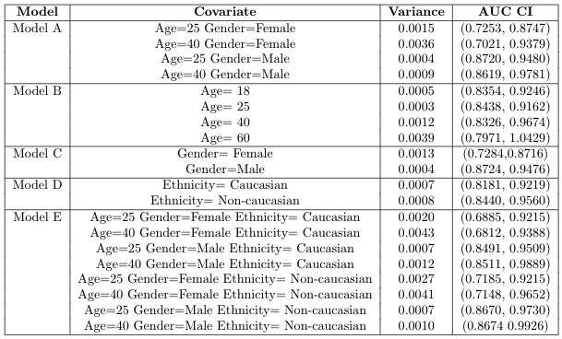
Variability of Covariate-Specific AUC

Slide 15
Introduction
Variability in the ROC curve
R Shiny App Application
Variability in covariate-specific ROC curve
ROC regression accounting for demographic effect
Variability in ROC curve in post Lasso selection

Slide 16
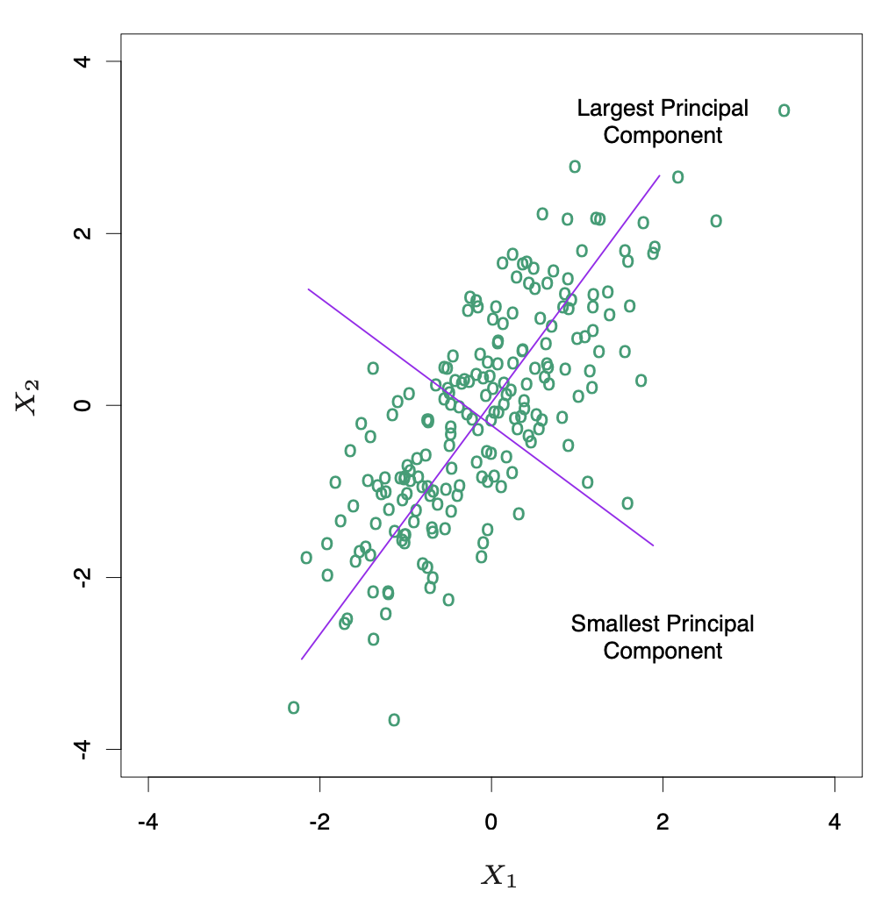
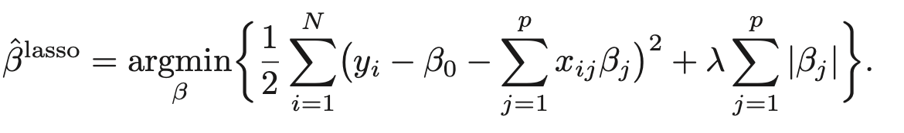
Dimension Reduction and Classification
Principal components analysis (PCA)
Choosing number of components covering 95% variance
Least absolute shrinkage and selection operator (Lasso)
y: outcome, x: variables, β: coefficient, λ: tunning parameter (cross validation)
The Lasso shrinks some of the coefficients to zero.
Hastie, et al., (2001)

Slide 17
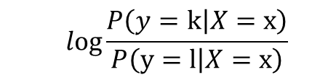
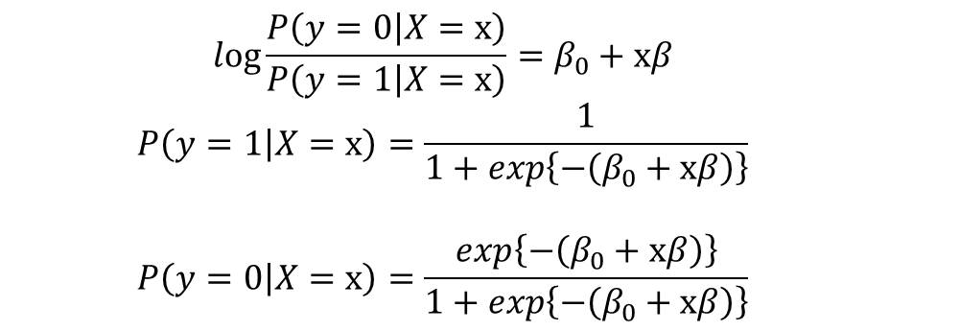
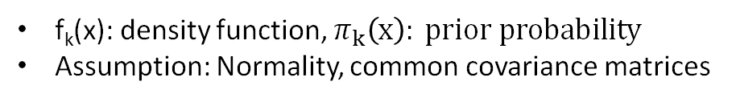
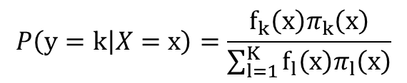
Comparison of PCA+LDA and Lasso+logistic (Rich, et al., 2020)
Linear Discriminant Analysis (LDA)
Logistic Regression
$$log\frac{P\left(\left.y=k\right|X=x\right)}{P\left(\left.y=l\right|X=x\right)}$$
$$log\frac{P\left(\left.y=0\right|X=x\right)}{P\left(\left.y=1\right|X=x\right)}=β_{0}+xβ$$
$$P\left(\left.y=1\right|X=x\right)=\frac{1}{1+exp\left\{−\left(β_{0}+xβ\right)\right\}}$$
$$P\left(\left.y=0\right|X=x\right)=\frac{exp\left\{−\left(β_{0}+xβ\right)\right\}}{1+exp\left\{−\left(β_{0}+xβ\right)\right\}}$$
$$P\left(\left.y=k\right|X=x\right)=\frac{f_{k}\left(x\right)π_{k}\left(x\right)}{\sum_{l=1}^{K}{f_{l}\left(x\right)π_{l}\left(x\right)}}$$
f_{k}(x): density function, $π_{k}\left(x\right): prior probability$
Assumption: Normality, common covariance matrices
PCA and LDA
Lasso and Logistic

Slide 18
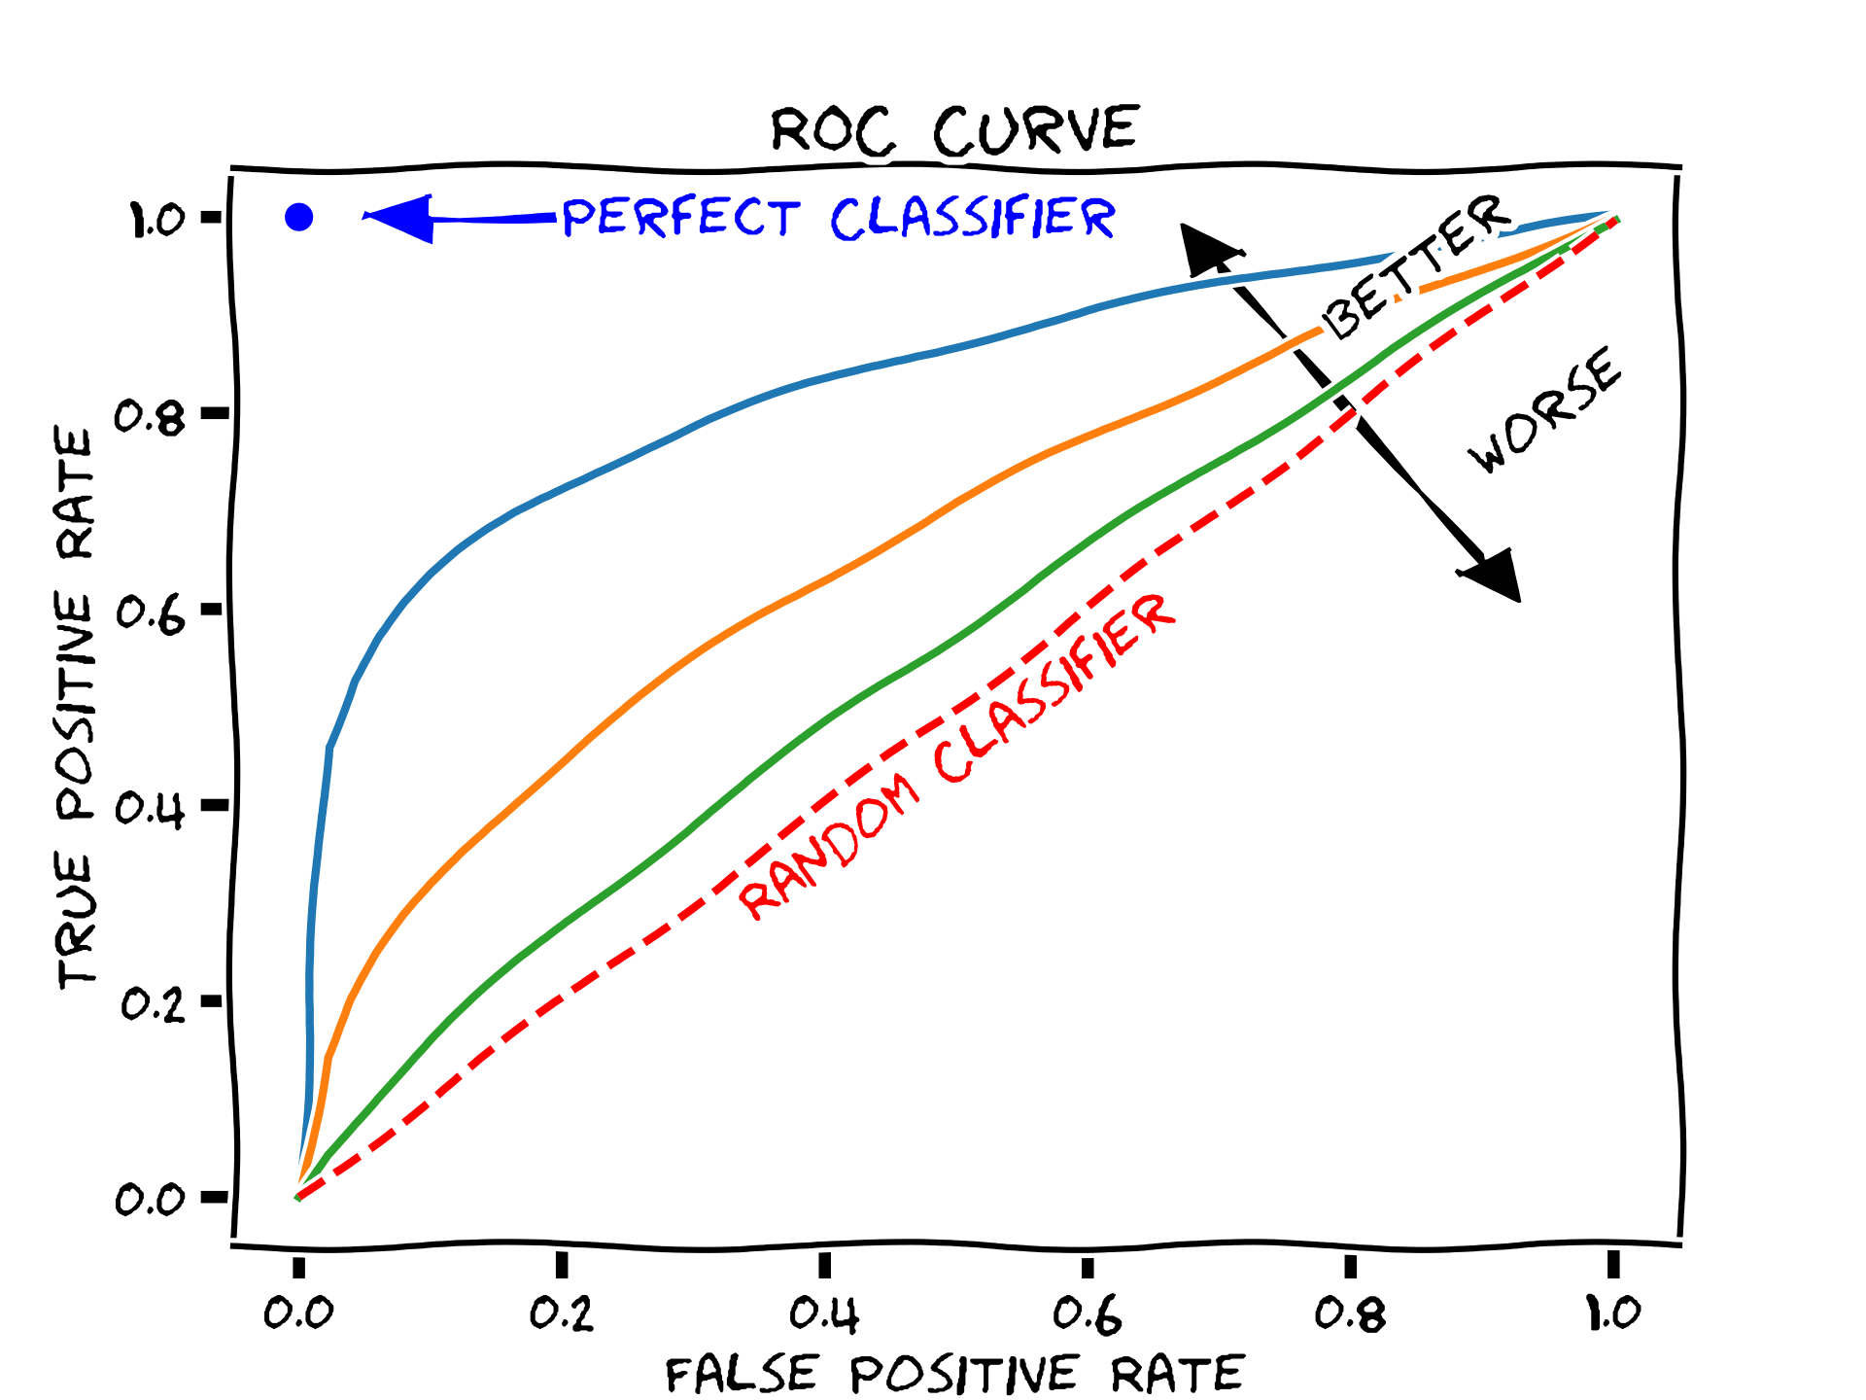
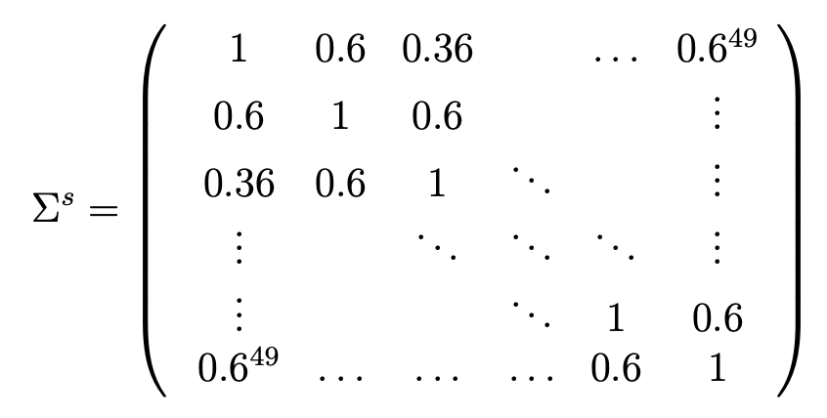
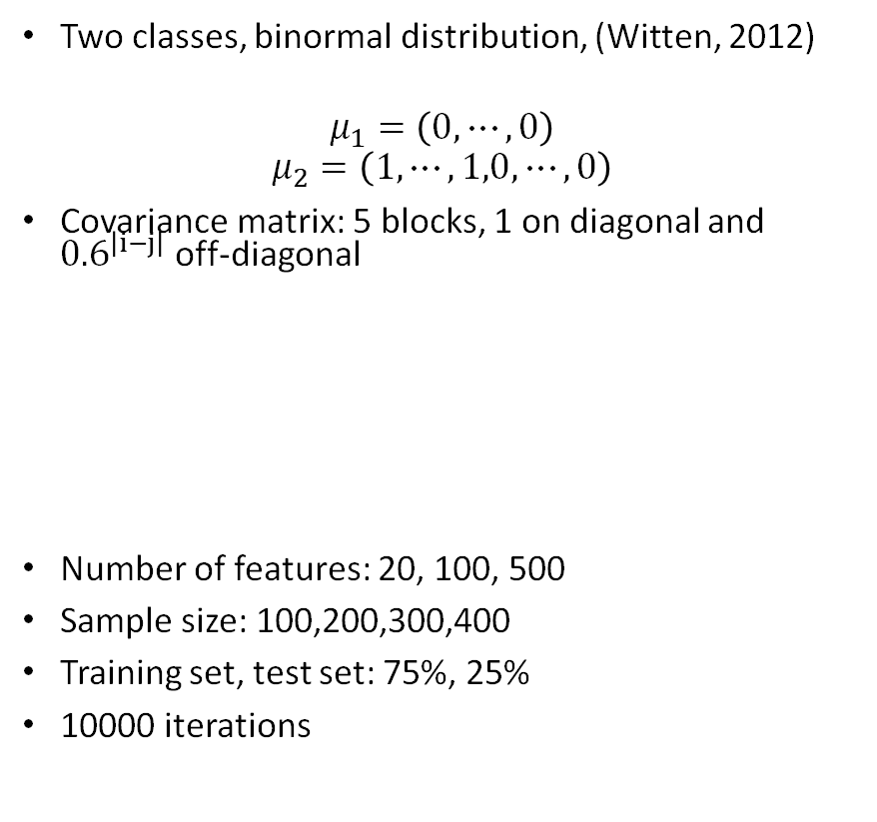
Simulation study
Two classes, binormal distribution, (Witten, 2012)
$$μ_{1}=\left(0,⋯,0\right)$$
$$μ_{2}=\left(1,⋯,1,0,⋯,0\right)$$
Covariance matrix: 5 blocks, 1 on diagonal and ${0.6}^{\left|i−j\right|}$ off-diagonal
Number of features: 20, 100, 500
Sample size: 100,200,300,400
Training set, test set: 75%, 25%
10000 iterations
ROC curves
Area under curves (AUC) used to evaluate

Slide 19
Results
500 features
20 features
Lasso+ logistic outerperforms PCA+ LDA

Slide 20
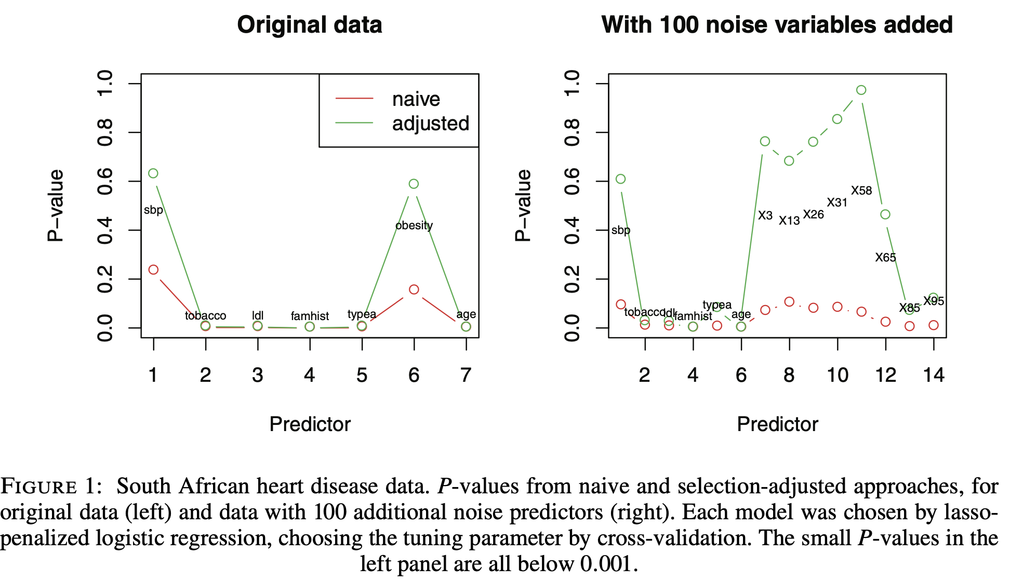
Post Selection for Lasso
(Taylor and Tibshirani 2018, Jason, et al. 2016)
Confidence interval for Lasso coefficients?
How uncertain is the accuracy?
How does sample size affect the uncertainty?
Notes:
Put figures in ref.

Slide 21
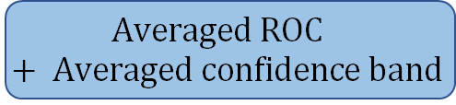

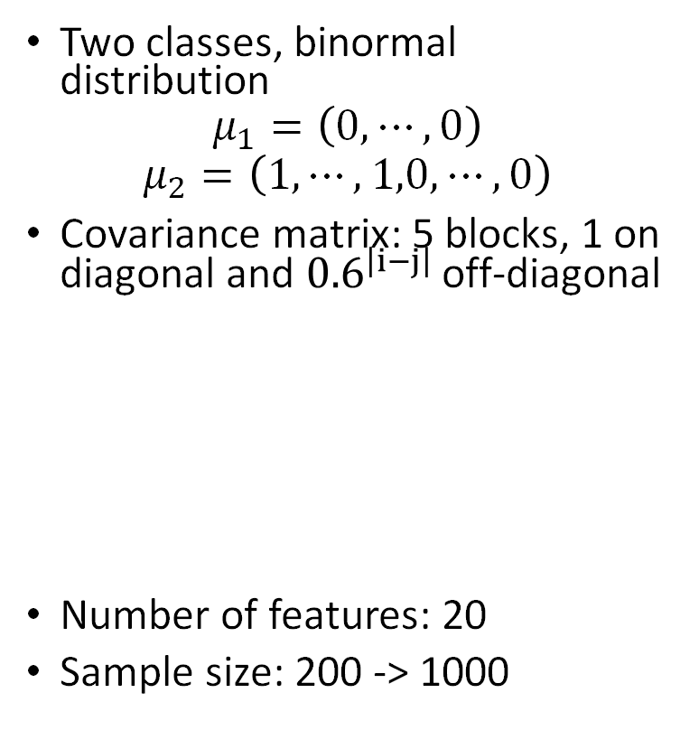
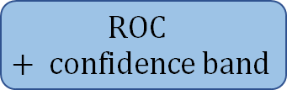
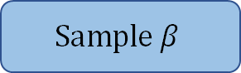
Procedure
Data
Data
10000 iterations
Two classes, binormal distribution
$$μ_{1}=\left(0,⋯,0\right)$$
$$μ_{2}=\left(1,⋯,1,0,⋯,0\right)$$
Covariance matrix: 5 blocks, 1 on diagonal and ${0.6}^{\left|i−j\right|}$ off-diagonal
Number of features: 20
Sample size: 200 -> 1000
Post Lasso Selection
$\hat{β}$,$σ_{\hat{β}}^{2}$
1000 samples
$$Sample β$$
Logistic equation
$$ROC+ confidence band$$
$$Averaged ROC+ Averaged confidence band$$
Notes:
Put figures in ref.

Slide 22

Lasso Coefficients
Larger sample size, smaller variance
$$β∼N\left(\hat{β},σ_{\hat{β}}^{2}\right)$$
1000 samples

Slide 23
Variability of ROC Curve
95% confidence band
Larger sample size -> narrower confidence band

Slide 24
Conclusion & Future Work
Uncertainty of the ROC curve with or without covariates
R Shiny app
Variability of ROC curves after Lasso selection
Post selection inference on accuracy measure based on testing data sets
Post Lasso selection inference for fire debris data

Slide 25

Acknowledgement
This work was partly supported in part by Awards No. 2018-DU-BX-0228 and No. 2019-DU-BX-0011 awarded by the National Institute of Justice, Office of Justice Programs, US Department of Justice. The opinions, findings, and conclusions or recommendations expressed in this publication are those of the authors and do not necessarily reflect those of the US Department of Justice.

Slide 26


Slide 27
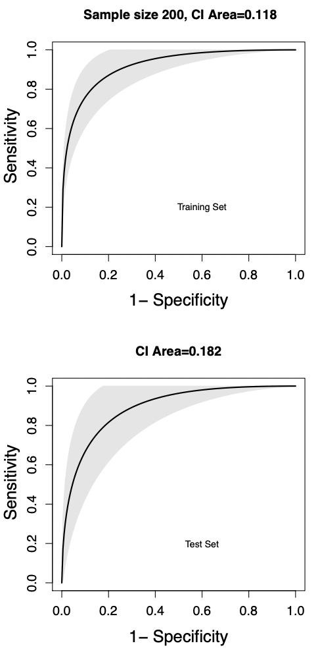
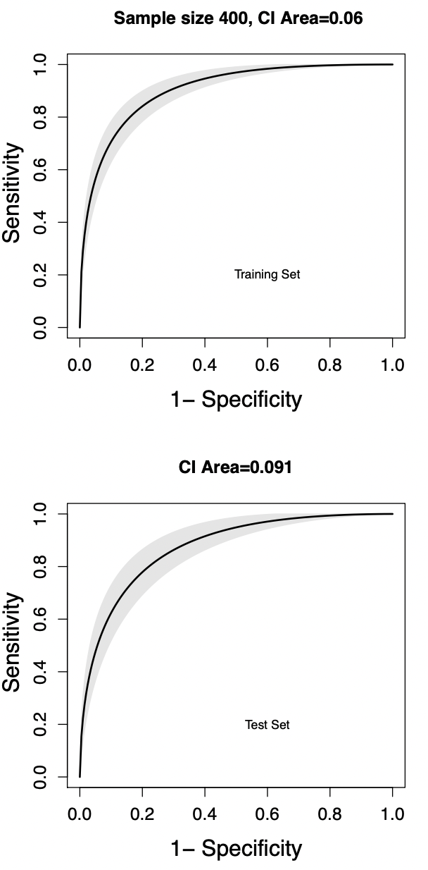
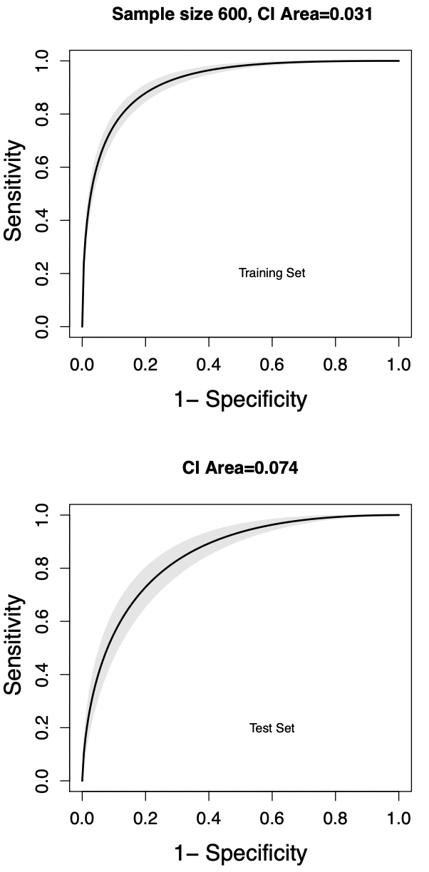
Variability of AUC: split data

Slide 28
Classification Results:
100 features

Slide 29
Classification Results
20 features
500 features

